Slide 1
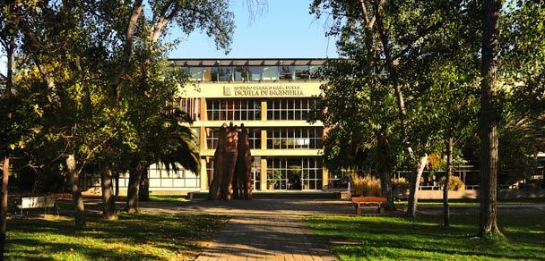
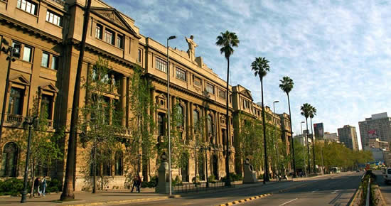
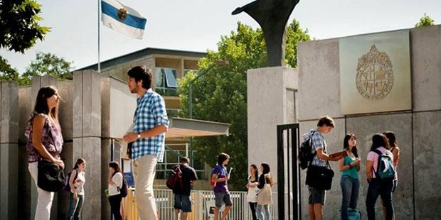


Multi-Slice Single-Breath-Hold Cardiac CINE with Slice and Time-Dependent Deep Image Prior at 1.5T and 0.55T
Rafael de la Sotta¹, Tabita Catalán^{1,2}, Francisco Sahli^{1,2,3}, *René Botnar^{1,2,3,4} and *Claudia Prieto^{1,2,3}
¹Millenium Institute for Intelligent Healthcare Engineering, Santiago, Chile ²School of Engineering, Pontificia Universidad Católica de Chile, Santiago, Chile
³Institute for Biological and Medical Engineering, Pontificia Universidad Católica de Chile, Santiago, Chile
⁴School of Biomedical Engineering, King's College London, London, United Kingdom
ISMRM 2025
#2617
Notes:
Hello everyone, my name is Rafael de la Sotta. I’ll be presenting our work titled Multi-Slice Single-Breath-Hold Cardiac CINE with Slice and Time-Dependent Deep Image Prior at 1.5 and 0.55T.

Slide 2
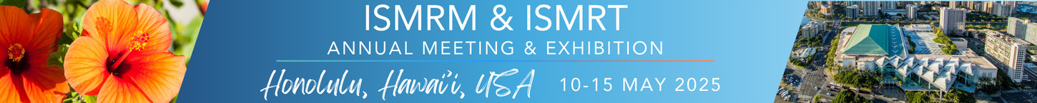
Declaration of Financial Interests or Relationships
Speaker Name: Rafael de la Sotta
I have no financial interests or relationships to disclose with regard to the subject matter of this presentation.
Notes:
I have nothing to disclose.

Slide 3
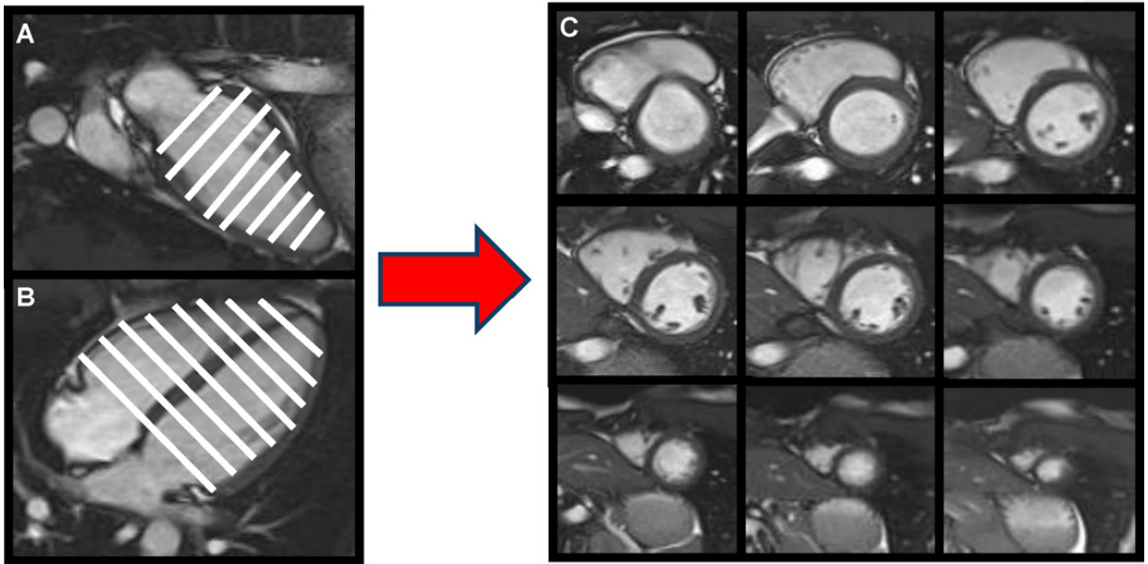
Motivation
Cardiac CINE MRI is the gold standard for the assessment of cardiac function.
Conventional cardiac CINE MRI requires multiple slices and breath-holds, leading to long scan times and to potential slice-misalignment.
Also, multiple breath-hold can be challenging for some patients.
3
3
#2617
¹Ahmed, Nasir, et al. Heart, Lung and Circulation. 2013
Notes:
Cardiac CINE MRI is the gold standard for assessing cardiac function.
However, conventional CINE MRI requires acquiring multiple slices across several breath-holds, which can be challenging for many patients, and leads to long scan times and to potential slice-misalignment.

Slide 4
Objective
To perform a multi-slice single-breath-hold cardiac CINE, reconstructed by a slice and time-dependent deep image prior (ST-DIP) network.
4
#2617
Notes:
Our goal is to achieve a multi-slice cardiac CINE imaging in a single breath-hold, at both 1.5 and 0.55T, making it more efficient and accessible.
For this purpose, we reduced the acquisition time for each cine and used a slice and time-dependent deep image prior neural network.
Our approach uses the same weights to reconstruct different cardiac cine slices, taking advantage of the redundancies between them.

Slide 5
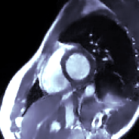
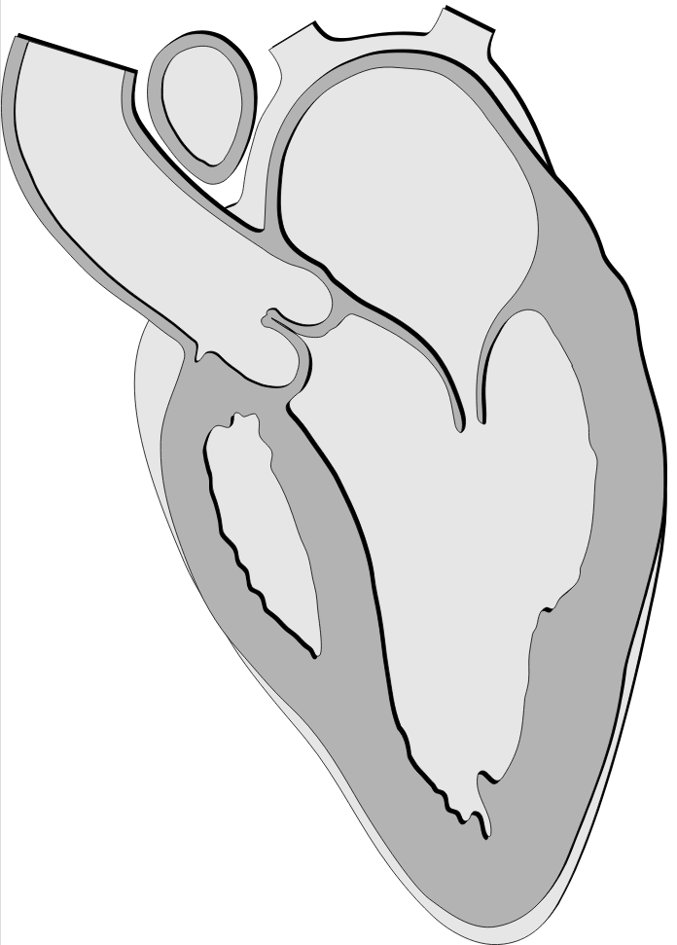
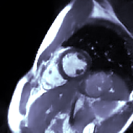
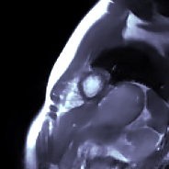
Method Overview
k_{y}
k_{x}
Slice 1
Slice 1
k_{y}
Slice 1
k_{x}
Slice 2
Simultaneous reconstruction by
ST-DIP
Slice 3
Sequential
single-breath-hold acquisition
Slice 2
Slice 2
k_{y}
k_{x}
Slice 3
Slice 3
5
#2617
Notes:
We sequentially acquire multiple slices across the left ventricle in a single breathhold, then all the slices are reconstructed simultaneously with our proposed method, ST-DIP.

Slide 6
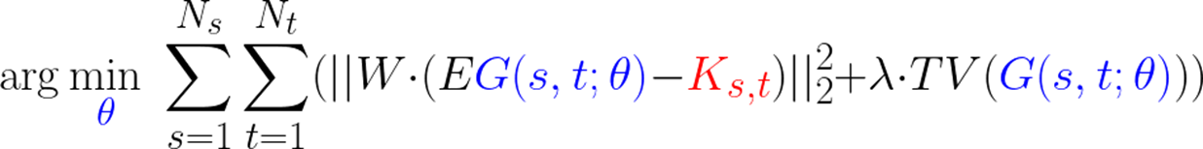
Slice and Time Dependent Deep Image Prior (ST-DIP)
In our loss function all slices (s) and frames (t) are reconstructed simultaneously.
G: Neural network
𝜃: parameters
K: Acquired data
E: Encoding operator
(Coil sensitivities,
Fourier Transform,
Undersampling)
W: Frequency weighting
TV: Total variation
N_{S}: Number of slices
N_{T}: Number of frames
Frequency-weighted consistency loss
Regularization
6
#2617
Notes:
All slices and frames are reconstructed simultaneously, sharing the same network weights.
Here the network is represented by a G of color blue, which has slice and time indices as inputs and theta as the network parameters.
The consistency loss compares the output of the network with the corresponding acquired data. For that purpose, the output of the network is transformed to frequency domain. To guide the learning, we use a frequency-weighted consistency loss that emphasizes high-frequency details
Additionally, Total variation regularization is used to get a more stable training, avoiding overfitting.

Slide 7
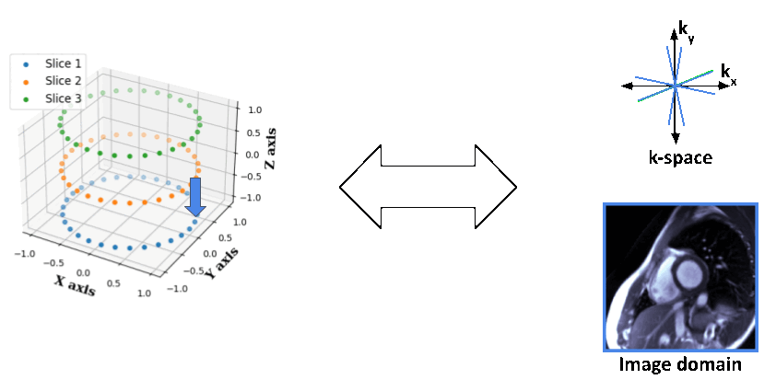
Slice and Time Dependent Deep Image Prior (ST-DIP)
We use a Fixed latent representation for multi-slice cardiac CINE
7
7
#2617
Notes:
We use a fixed latent representation for a multi-slice cardiac cine.
Each circle represent a cardiac cine, and each point represent a cardiac phase.
Each point of the latent representation is associated with the corresponding acquired k-space data of that particular slice and frame.

Slide 8
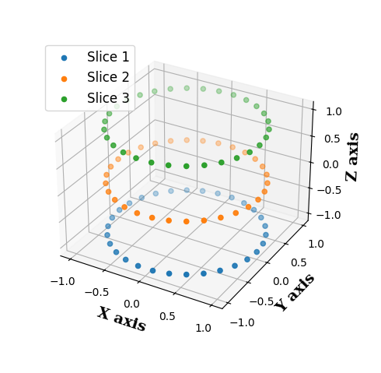

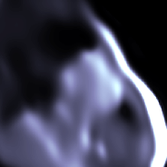
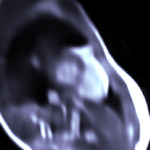
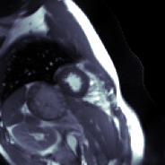
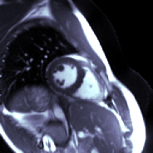
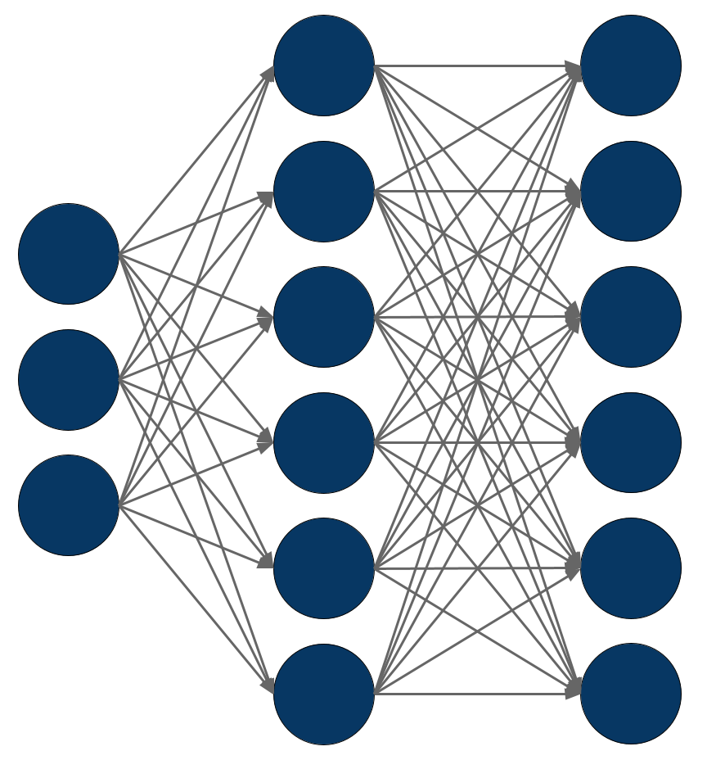





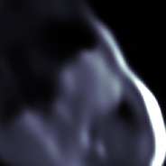
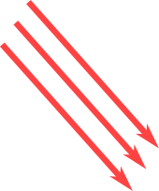

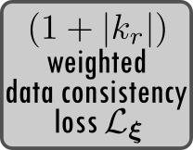
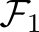
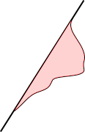
Slice and Time Dependent Deep Image Prior (ST-DIP)
Latent representation
Generated image
Point
ST-DIP
MapNet
Generator
Map
Acquired k-space
k-space from generated image
Radon transform
k_{y}
k_{y}
k_{x}
k_{x}
8
8
#2617
Notes:
For each iteration of our method, the network samples a point from the manifold, generates a synthetic image, and compares it to the corresponding acquired k-space data.
The loss is computed in frequency domain, so the generated image is transformed from image to frequency domain in two steps: A radon transform, and a 1D Fourier transform.
Then, the acquired and the generated k-space are compared by a frequency weight data consistency loss function.
At the beginning the output of the network is just noise, but thanks to the consistency loss, the network learns to map the latent representation into the corresponding image for each particular slice and frame.

Slide 9
In-vivo experiments
We tested our method at 0.55T and 1.5T.
 |  | 1.5T | 0.55T
Acquisition | FOV (mm) | 256 x 256 | 256 x 256
 | Resolution (mm) | 2 x 2 | 2 x 2
 | Thickness (mm) | 8 | 10
 | TE / TR (ms) | 1.16 / 2.3 | 2.85 / 5.7
 | FA (°) | 60 | 78
 | Number of slices | 8 | 8
 | Acquisition time per slice (s) | 1 | 1.5
Reconstruction | Cardiac phase bins | 30 | 30
 | Undersampling factor / bin | 17 | 32
9
9
#2617
Notes:
Here are the acquisition parameters.
The field of view, resolution, and number of slices are consistent between both fields.
We acquired 8 slices for 1.5 and 0.55T.
At 1.5T each slice is acquired in 1s. At 0.55T, each slice is acquired in 1.5s, resulting in a total scan time of 8 and 12 seconds, respectably.
Each slice was binned into 30 cardiac phases, resulting in a high acceleration factor per frame.

Slide 10
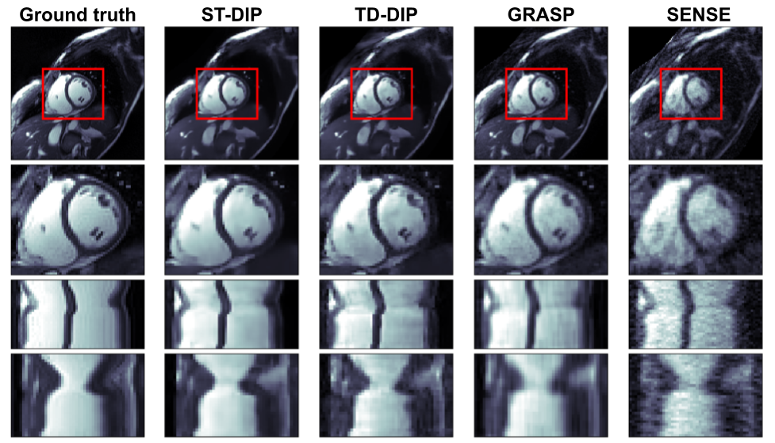
Results: High-quality images at 1.5T
Ground truth
ST-DIP (Ours)
TD-DIP¹
GRASP²
SENSE³
10
10
#2617
¹Yoo, Jaejun, et al. IEEE Trans Med Imaging. 2021. ²Feng, Li, et al. Magn Reson Med. 2014. ³Pruessmann, Klass, et al. Magn Reson Med. 1999
Notes:
Here we compare our approach with standard reconstructions methods, GRASP, and SENSE, and also with TD-DIP, which reconstruct all the frames together.
ST-DIP yields visibly sharper images with fewer artifacts.

Slide 11
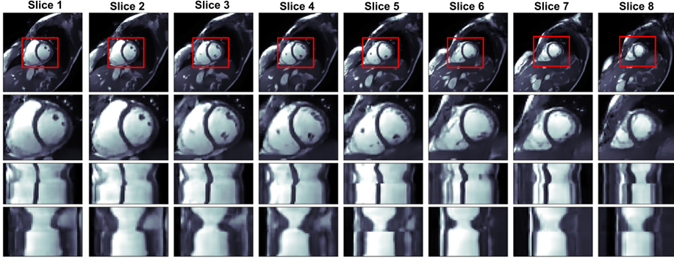
Results: High-quality images at 1.5T
11
11
#2617
Notes:
Here we can see eight cardiac cine slices at 1.5T, acquired during 1s each and reconstructed simultaneously by the proposed framework ST-DIP.
As can be seen, good image quality is obtained across the whole left ventricle.

Slide 12
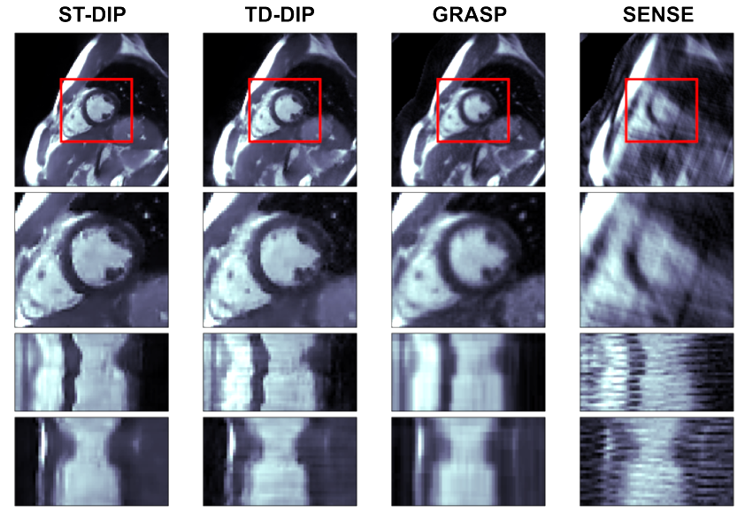
Results: High-quality images at 0.55T
ST-DIP (Ours)
TD-DIP¹
GRASP²
SENSE³
12
12
#2617
¹Yoo, Jaejun, et al. IEEE Trans Med Imaging. 2021. ²Feng, Li, et al. Magn Reson Med. 2014. ³Pruessmann, Klass, et al. Magn Reson Med. 1999
Notes:
At 0.55T, the challenge is even greater due to lower SNR.
Still, ST-DIP outperforms the other methods, recovering cardiac anatomy more clearly while suppressing undersampling artifacts.

Slide 13
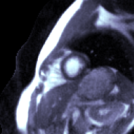
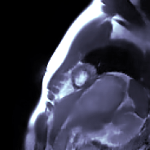
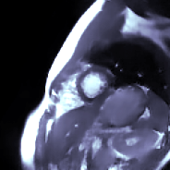
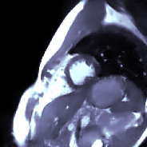
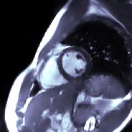
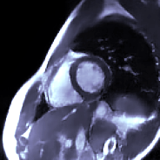
Results: High-quality images at 0.55T
13
13
#2617
Notes:
Here we can see the 8 slices acquired during the same breath-hold and reconstructed with our proposed slice and time-dependent deep image prior.
All the slices show good image quality, which corroborate the feasibility of a multi-slice single-breath-hold cardiac cine at 0.55T.

Slide 14
Conclusions
8 cardiac cines in a single breath-hold at 1.5 and 0.55 T.
Slice and time-dependent DIP method.
(see #2629 for a motion corrected approach)
Outperform conventional reconstruction approaches and TD-DIP.
Future work
Validation with patients.
14
14
#2617
Notes:
To summarize, our method allows the acquisition of 8 cardiac CINE slices in 8 seconds at 1.5T and 12 seconds at 0.55T, all within a single breath-hold.
We use a slice and time-dependent deep image prior neural network, which reconstruct all slices together, sharing the same weights.
(for see another approach please see presentation #2629)
Our method outpermorns conventional reconstruction approaches and TD-DIP, where all frames are reconstructed together. The joint reconstruction approach improves image quality over independent slice reconstructions.
For future work, validation in patients is required.

Slide 15
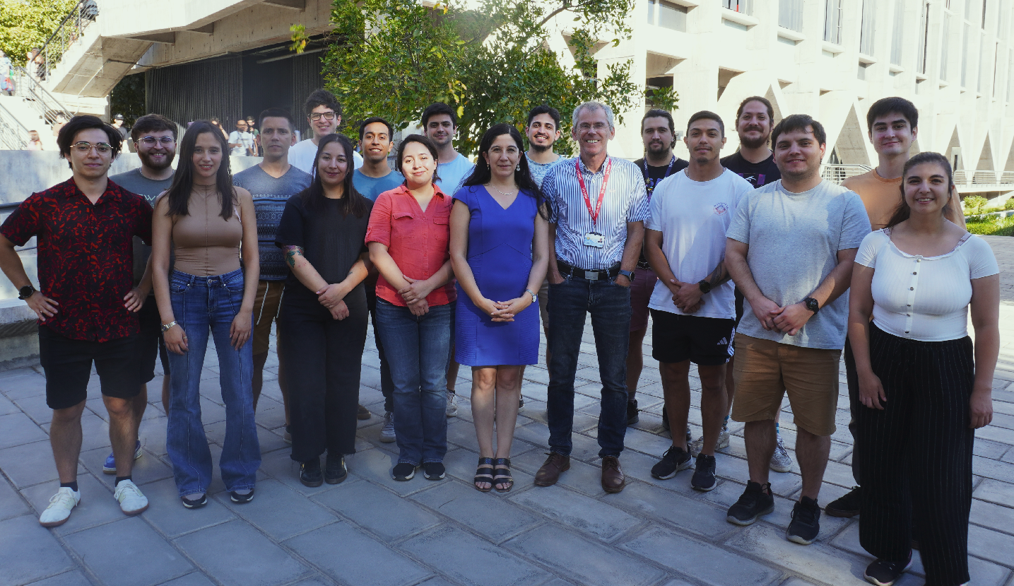




Acknowledgements
https://i-health.cl/
@iHEALTHMilenio
@KCL_CardiacMR
This work was funded by ANID - Millennium Science Initiative Program - ICN2021_004
15
15
#2617
Notes:
Thank you for your attention.
We would like thank to iHEALTH, Universidad Católica, and King’s College London

